Slide 1

LOAN DEFAULT PREDICTION
By karthick ramnathan

Slide 2

WHY SO IMPORTANT?
This loan default prediction means that customers with financial difficulties will be flagged up sooner rather than later. So, you can address issues before they arise – and before a customer defaults. This is proactive credit risk management.

Slide 3

OBJECTIVE
Predict weather the customer will default or not

Slide 4
METADATA
TARGET – Default/Not Default
CODE_GENDER=M/F
CNT_CHILDREN-Count Of Children
NAME_INCOME_TYPE -Income Type
NAME_EDUCATION_TYPE-Education type
NAME_HOUSING_TYPE-Housing Type
DAYS_REGISTRATION –Days before application changed his registration
DAYS_ID_PUBLISH-Days before applicant changed his phone no
FLAG_MOBIL-Number given or not
FLAG_EMP_PHONE- MOBIL-Number given or not
FLAG_CONT_MOBILE –Number reachable or not
FLAG_WORK_PHONE-Work number given or not
CNT_FAM_MEMBERS –count of family numbers
REG_REGION_NOT_WORK_REGION - permanent address does not match work address
LIVE_REGION_NOT_WORK_REGION - contact address does not match work address
DAYS_LAST_PHONE_CHANGE – Days before phone no changed
'FLAG_OWN_CAR’, -Owns car or not
'AMT_INCOME_TOTAL’, Total income
'AMT_CREDIT’,Loan amount
'AMT_ANNUITY’=EMI
,AMT_GOODS_PRICE’-it is the price of the goods for which the loan is given
REG_REGION_NOT_LIVE_REGION- permanent address does not match contact address

Slide 5
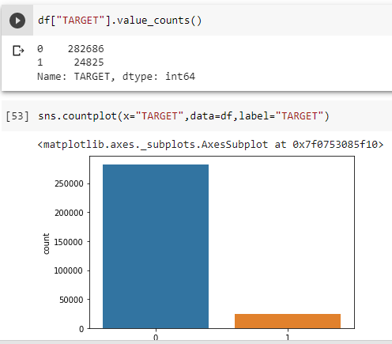
Imbalanced data
Our target variable is imbalanced
Count of not default is higher than the count of default
The machine learning model will be unable to learn more about defaulters
In order to tackle the problem, we are using a library called imblearn
In the imblearn we are using two algorithm
RandomOverSampler
RandomUnderSampler

Slide 6
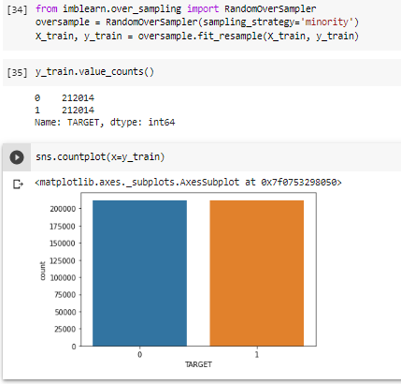
Random over sampling
It increases the no of samples where the sample size is minimum

Slide 7
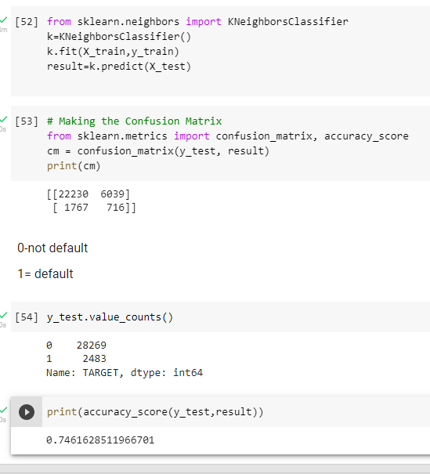
ALGORITHM USED
We have used k-neighbor classifier
Why K-neighbor classifier?
The KNN algorithm uses 'feature similarity' to predict the values of any new data points.
This means that the new point is assigned a value based on how closely it resembles the points in the training set

Slide 8
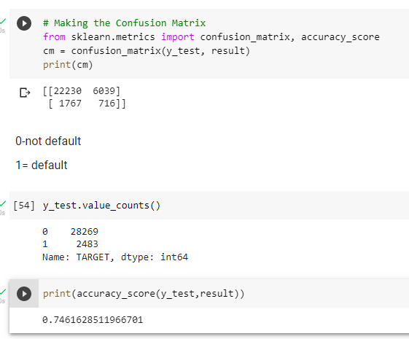
MODEL OUTPUT

Slide 9
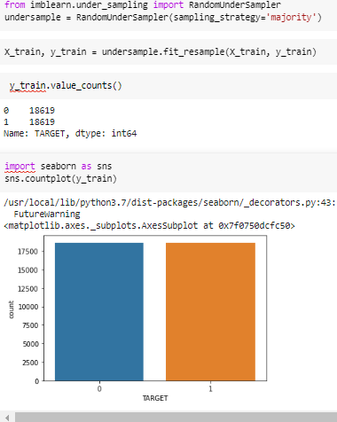
Random under sampling
It reduces the no of samples where the sample size is maximum

Slide 10
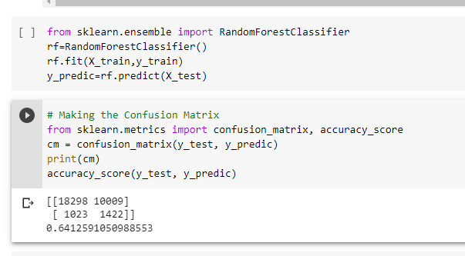
ALGORITHM USED
We have used random forest classifier
Why random forest?
It is a bagging technique
Random forest algorithms can discover rich relationships between predictors and the response automatically.
It can easily handle more predictors than the number of response

Slide 11
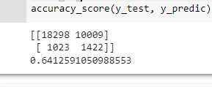
MODEL OUTPUT

Slide 12
conclusion
The goal of this project is to build a machine learning model that can predict if a person will default on the loan based on the loan and personal information provided.
The model is intended to be used as a reference tool for the client and his financial institution to help make decisions on issuing loans, so that the risk can be lowered, and the profit can be maximized.

